Slide 1


PACE CODING PROGRAM 2019
Coding for community

Slide 2

introduction

Slide 3
Program’s Objectives
Have
basic programming knowledge
Understand
C# and .net framework
Solve
a number of programming problems & challenges
Create
simple applications
Have
fun learning

Slide 4

grand rubric
Switch off your phone
Respect yourself, others & environment
Be Punctual

Slide 5

Quick intro
jack mutobu
strathmore university
BSC computer science 2nd year

Slide 6

. . .
Live each day as if it were your last, learn as if you’ll live forever
☺
Mahatma Gandhi
. . .
Ooko Emmanuel
strathmore university
BSC computer science 2nd year

Slide 7

Introduction to programming
in C# programming language
on .NET framework
Notes:
C# is a programming language just like many other… examples of programming languages you know?
Understand programming
.NET framework

Slide 8
Today’s objectives
Understand Programming
An ide (Internal development environment)
Levels of programming
Compilation and translation
Course tools (C# | .Net Framework | visual studio)
Visual studio installation

Slide 9
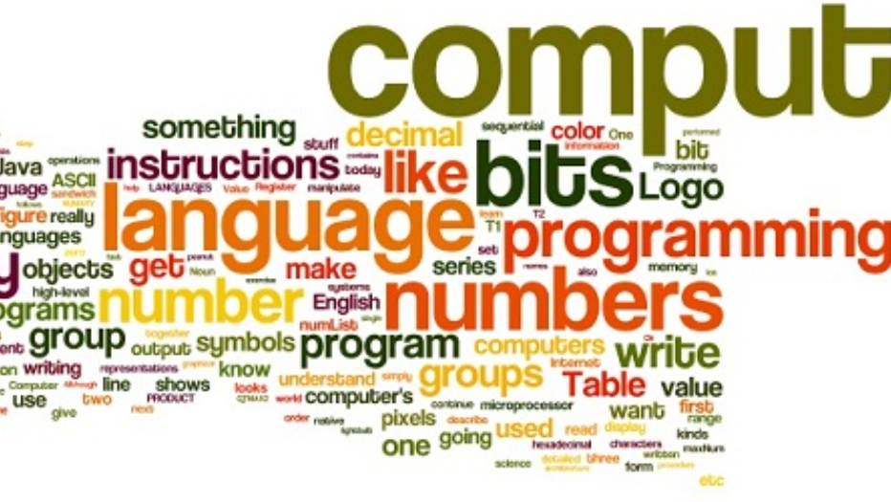

What is programming?

Slide 10
Programming is a creative activity that consists of giving instructions to a computer so that it can perform a specific task.
Programs
A program is a set of instructions written in a specific language that guides a computer on how to execute a task.
Examples of programs you know…

Slide 11
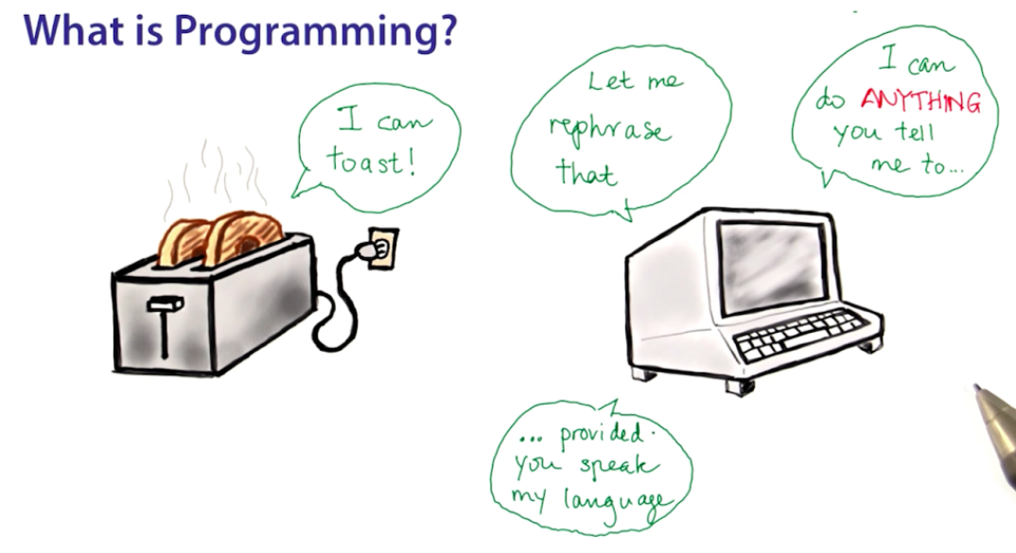

Slide 12
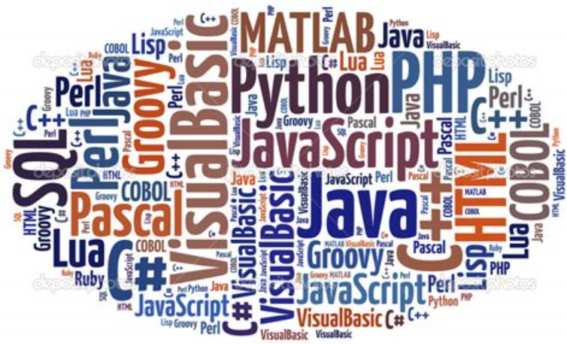
What is a programming language?

Slide 13
“
A programming language is a computer language engineered to create a standard form of commands. These commands can be interpreted into a code understood by a machine.
Notes:
Examples of programming languages that you know?

Slide 14
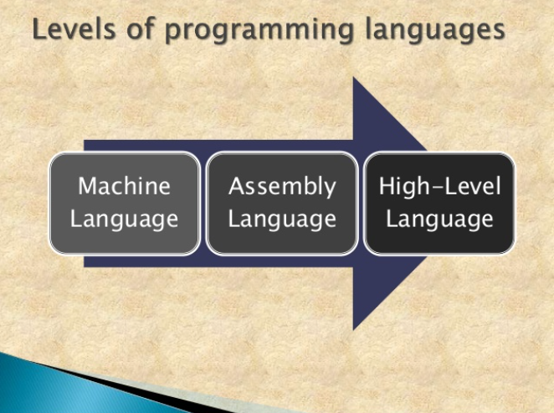
Notes:
Two levels of programming lang’s
High level
Low level

Slide 15
Low level languages
1. Machine languages
Native code, directly executed by the hardware.
2. Assembly languages
Machine language instructions are replaced with simple pneumonic abbreviations (Symbols) (e.g., ADD, MOV).

Slide 16
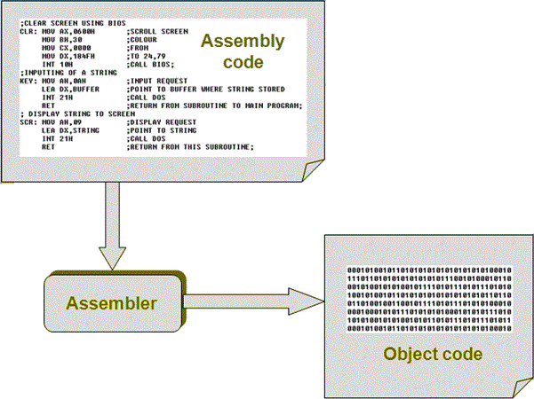
An assembler translates assembly code into binary code.
Notes:
What’s binary code or numbers / language?

Slide 17
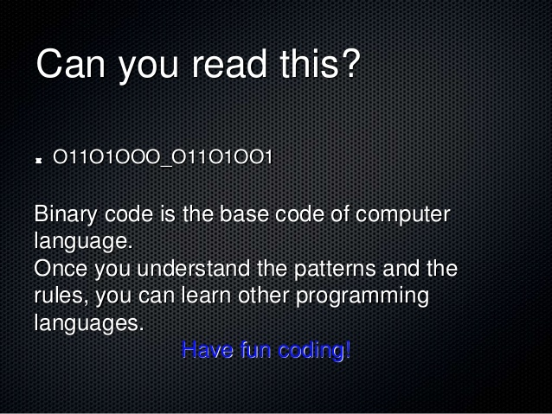
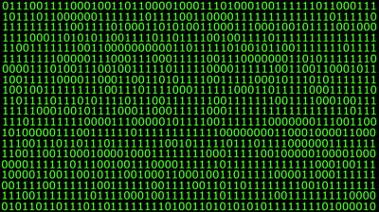

How are programs created?
Did you know that your computer only understands binary language ☺?

Slide 18
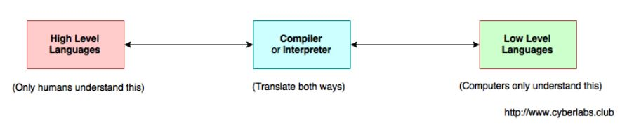
High Level Languages
High level languages have a syntax that is close to human languages. For the code to be translated into machine language, an interpreter or compiler is required.
Interpretation
Compilation
Notes:
Example of high level languages…
Java, python,
What’s a Syntax?

Slide 19
Syntax
A set of rules that defines the combinations of symbols that are considered to be a correctly structured source code.

Slide 20
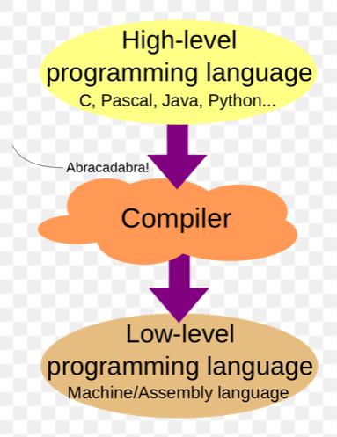

Slide 21
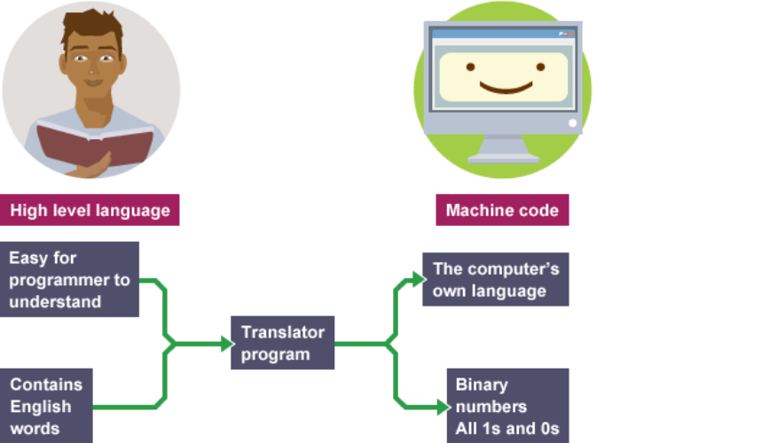
Notes:
Translator or compiler?

Slide 22
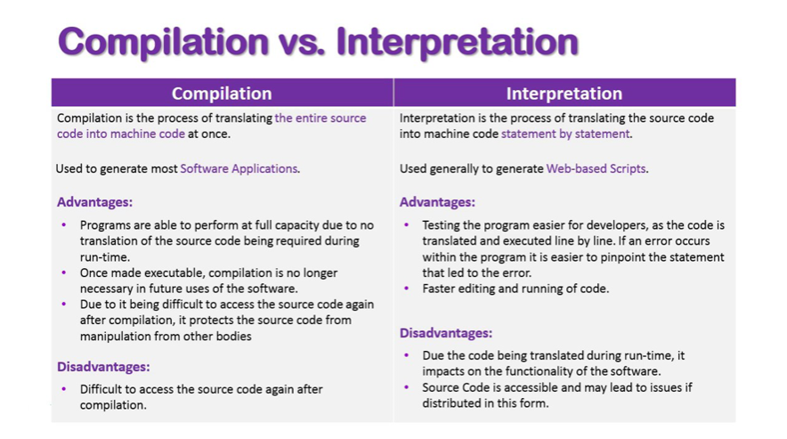
Notes:
Interpretation is a process whereby a computer program called interpreter read the code line by line and executes it directly.
Compilation is a process whereby a computer program called compiler translate the entire code once into object code.

Slide 23

Compilation
Traditional compilers used by traditional languages such us C, C++ translates human readable code into specific binary code for each platform it is executed on.
printf(“Hello World”)
Binary code executed by your PC
You write your program(C#,C++,C)
Compilation(Translation)
Notes:
This types of compilation is still widely used today but has one problem one have to use a different compiler for each platform.

Slide 24
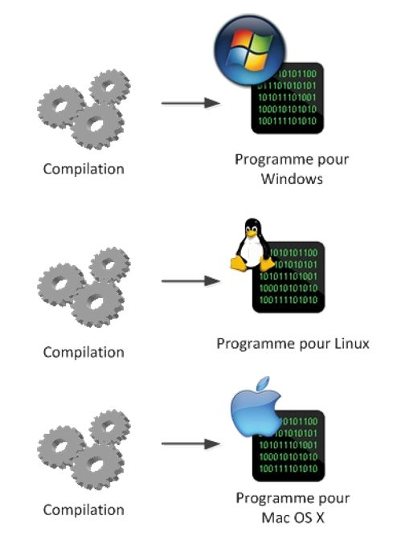
Traditional compilers
Compilation
Program for Windows
Compilation
Program for Linux
Compilation
Program for Mac OS
Notes:
You need to compile your code for each environment(Operating System)

Slide 25
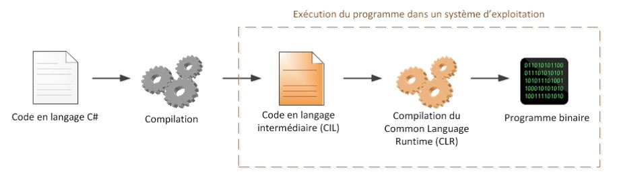
Modern compilers
Modern programming languages such as Java and C# solve this problem of compatibility by creating a virtual environment adapted to every platform. What this means is that you no longer need to use different compilers for each platform.
Execution of the program in an operating system
Code in C#
Compilation
Code in Intermediate Language(CIL or IL)
Common Language Runtime(CLR)
Binary Code
Notes:
The intermediate Language code (CIL) is the program you are going to distribute. On Windows It takes the appearance of a .exe like the usual programs, but it does not contain a binary.

Slide 26

C# .NET Framework

Slide 27
C# (pronounced "C-sharp") is an object-oriented programming language from Microsoft inspired by C++ .C# is used on the .Net Framework to build powerful programs.

Slide 28
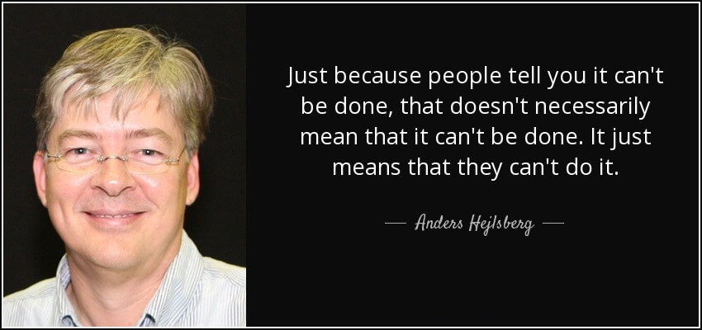
C# and .NET Framework
A brief history of C# as a programming language
Notes:
Microsoft is the source of the .net project and its C# language. In 2001, Anders Hejlsberg (the creator of the Delphi language), employed at Microsoft, creates the .net framework (pronounced as “dotnet") and its flagship language: C# (pronounced as "C sharp "). Both are complementary, as we will see further.
In 2002, the first version of .Net was developed and the Microsoft development environment, Visual Studio, was updated to version 7.0 to integrate the .Net Framework. Several important versions of the .Net framework have followed: 2.0, 3.0, 3.5, 4.0.
Currently, the latest version of the .Net framework is the 4.7, released in 2018. To accompany this output, the integrated development environment (the software that allows to write code) has also evolved. To work in C#, Studio 2017 is now used. Older versions still work but it is recommended to update.

Slide 29
.NET Framework is a managed execution environment that provides a variety of services to its running applications.
Has two major components:
1. Common language runtime (CLR), an execution engine that handles running applications;
2. .NET Framework Class Library, which provides a library of tested, reusable code that developers can call from their own applications.

Slide 30
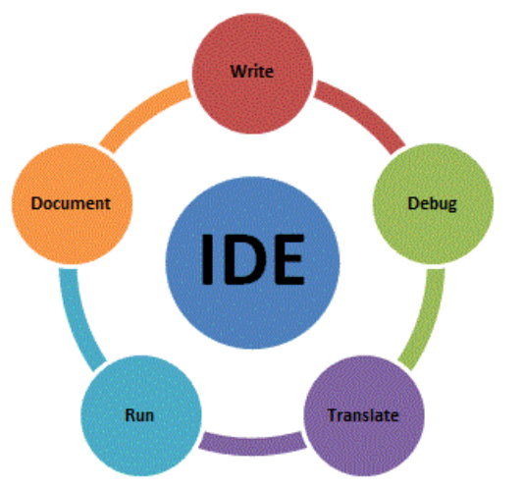
WHAT IS AN IDE?

Slide 31

C# and .NET Framework
Integrated Development Environment(IDE)
A software application that provides comprehensive facilities to computer programmers for software development
Unfortunately, they do not write the code for us!
i.E (JetBrains, MonoDevelop, Visual Studio Code, etc). In this course we will be using Visual Studio 2017.
Notes:
Phone with an autocorrect
Any examples of IDE’s you know?

Slide 32
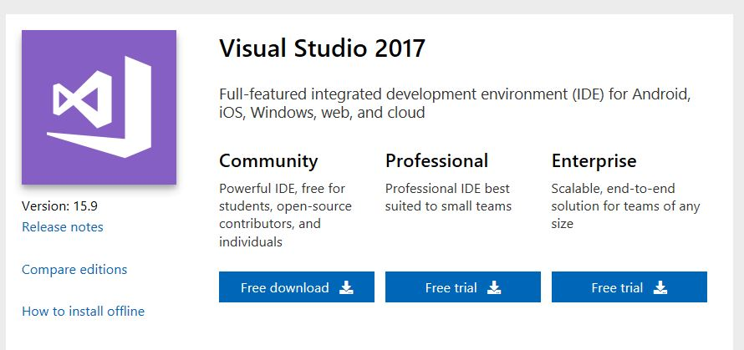
C# and .NET Framework
Installing Visual Studio 2017
1. Go to https://visualstudio.microsoft.com/downloads/
2. Click Free download
Notes:
Check if your computer specs the VS one
64 bit or 32 bits windows/Mac/Linux

Slide 33
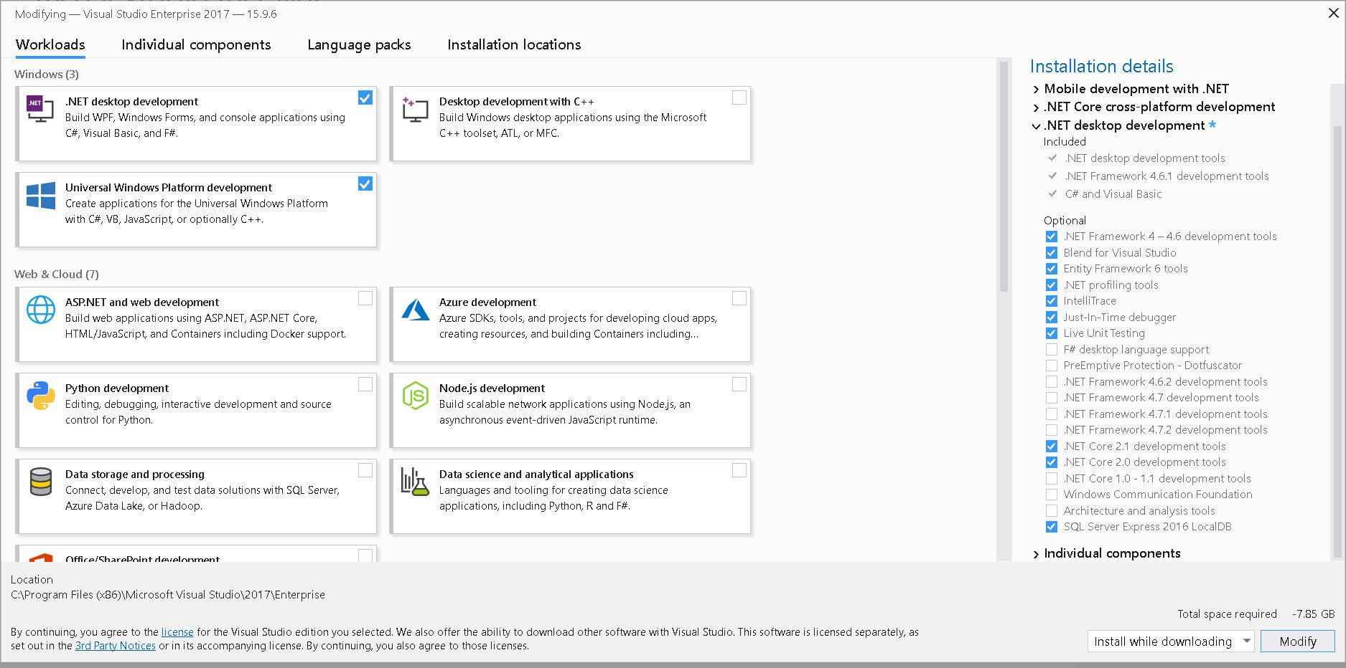
C# and .NET Framework
Installing Visual Studio 2017
3. Run the Installer
4. Select these checkboxes

Slide 34
C# and .NET Framework
Installing Visual Studio 2017

Slide 35

C# and .NET Framework
Kindly wait for the installation to finish!

Slide 36

The end
Thank you

